Slide 1
CSS

Slide 2
Flexbox

Slide 3
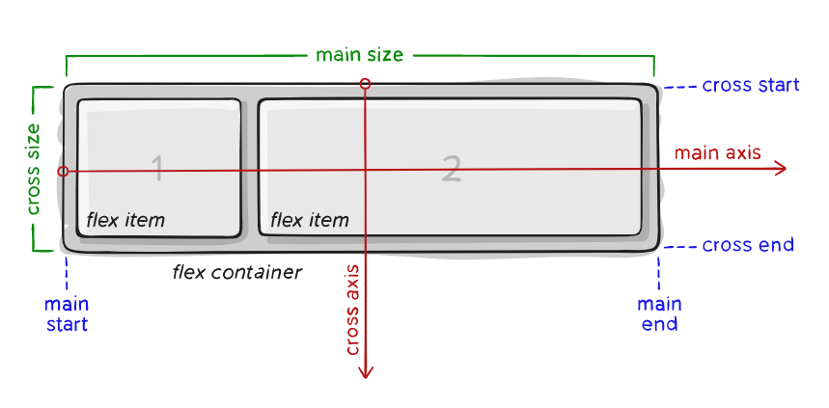
Basic Terminology

Slide 4
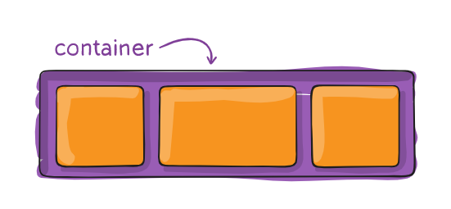
Properties for the Parent ( flex container )
display: flex;
flex-direction: row | row-reverse | column | column-reverse;
justify-content: flex-start | flex-end | center | space-between | space-around;
align-items: stretch | flex-start | flex-end | center | start | end;

Slide 5
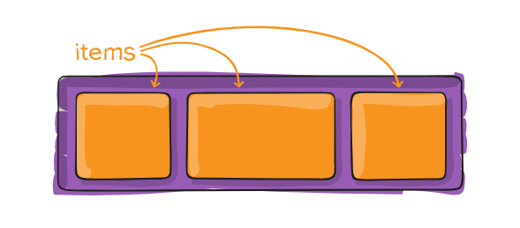
Properties for the Child ( flex items )
order: 5;
/* default is 0 */
flex-grow: 4;
/* default is 0 */
align-self: auto | flex-start | flex-end | center | stretch;

